Slide 1
WOODLAND SCHOOL DISTRICT 2022-2023 YEAR END FINANCIAL SUMMARY
Presented by:
Stacy Brown
Exec Director of Business Services

Slide 2
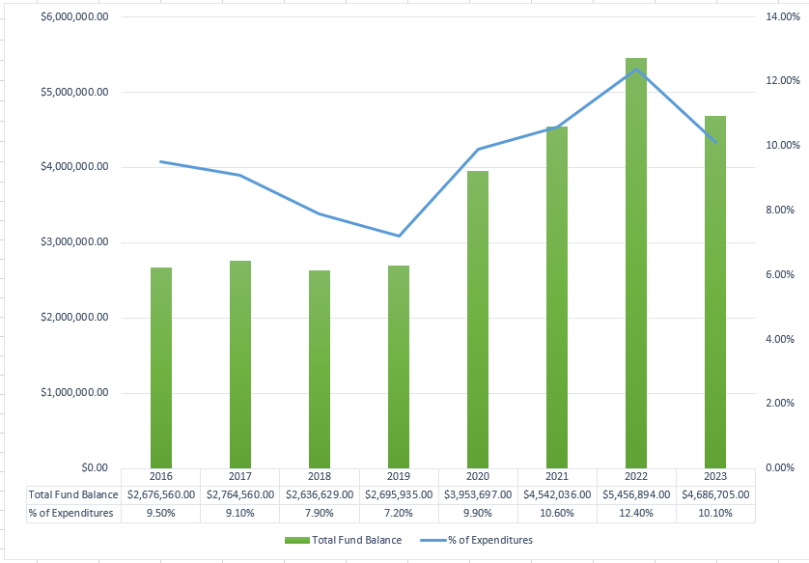
History of Total Fund Balance at Year-End and the Percentage of Budgeted Expenditures

Slide 3
Fund Balance/Enrollment
 | August 31, 2023 | August 31, 2022
Total Ending Fund Bal – (SF0/SF1) | $4,686,705 $2,267,277/$2,419,429 | $5,456,894 $2,897,528/$2,559,366
Restricted for Pgm Carryover | $ 0 | $ 849
Nonspendable for Prepaid Exp | $ 76,195 | $ 151,600
Assigned for Building/Dept CO – 2022 inc ELA Curriculum | $ 285,242 | $ 709,220
Unassigned Fund Bal | $4,325,268 | $4,595,225
Unreserved FB Decrease 21-22 to 22-23 | ($ 269,957) | $ 548,986
Budgeted Inc/(Dec) in FB | ($ 616,250) | ($ 493,807)
Actual Inc/(Dec) in FB | ($ 770,189) | $ 914,858
Budgeted Enrollment | 2,312.00 | 2,306.00
Actual Enrollment | 2,344.02 | 2,285.52

Slide 4
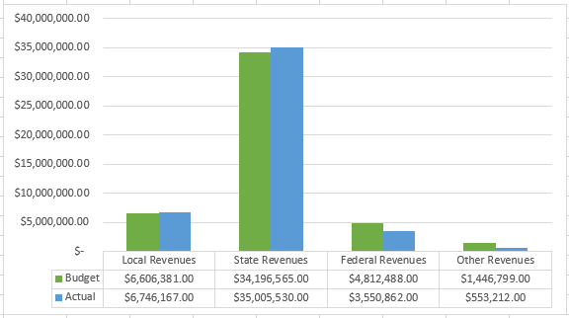
GF Revenues – Budget Compared to Actual

Slide 5
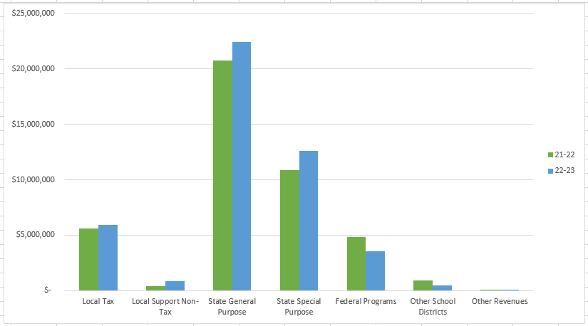
Revenues Compared to Prior Year

Slide 6
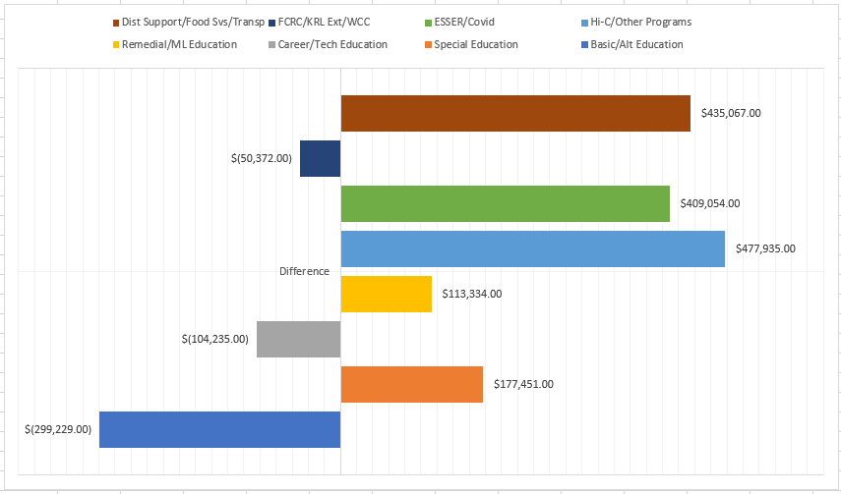
GF Program Expenditures – Variance to Budget

Slide 7
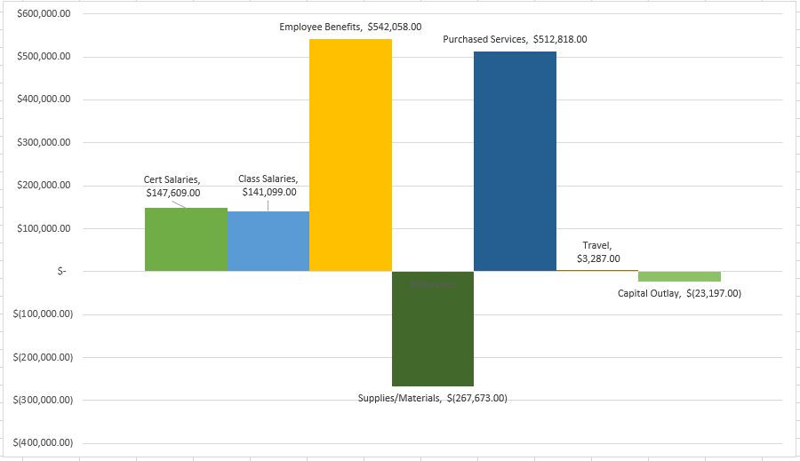
GF Object Expenditures – Variance to Budget

Slide 8
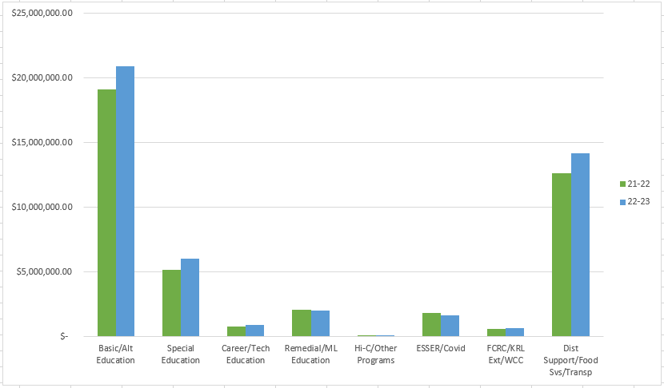
Program Expenditures Compared to Prior Year

Slide 9
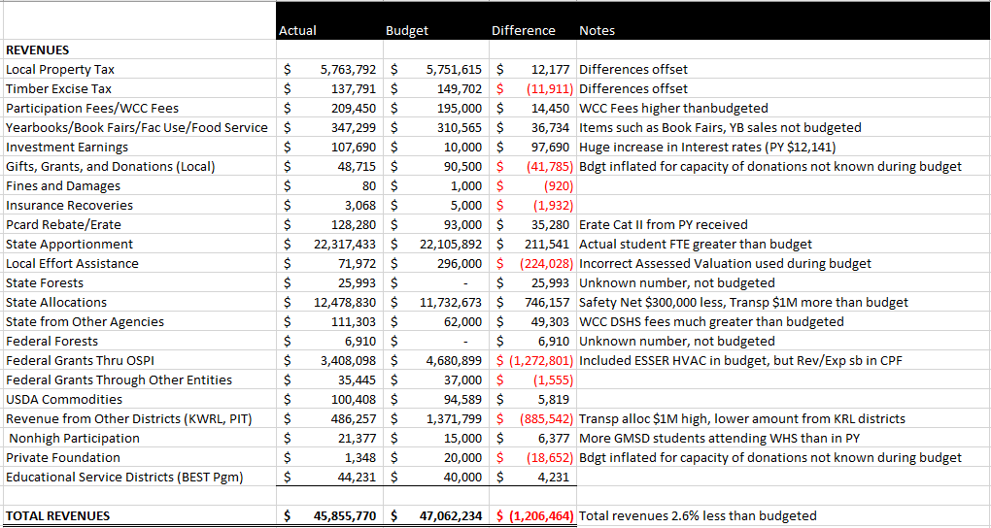
Detail Revenues Compared to Budget

Slide 10
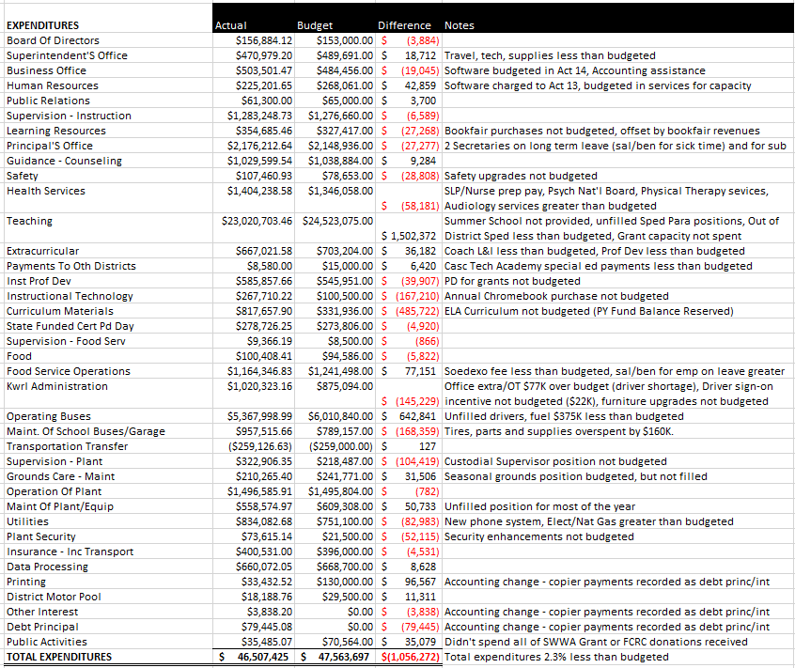
Detailed Expenditures (by Activity) Compared to Budget

Slide 11
Levy/Local Funds
Expenditure Type | Levy Dollars 2022-2023 | Levy Dollars 2021-2022
Certificated Salaries | $ 832,000 | $ 729,700
Classified Salaries | $ 2,186,000 | $ 1,757,000
Administrator Salaries | $ 481,500 | $ 452,500
Benefits | $ 1,328,000 | $ 1,201,500
Supplies/Services/Travel/Utilities/Insurance | $ 467,000 | $ 79,000
Extracurricular | $ 661,500 | $ 612,500
Special Education | $ 777,400 | $ 56,000
Food Service Program | $ 156,000 | $ 0
To/From Transportation/Bus Purchase | $ 168,000 | $ 474,500
Daycare | $ 86,000 | $ 73,000
Family Resource Center | $ 12,300 | $ 0

Slide 12
Transportation & Food Service
Transportation
Food Service
Total Students transported = Approx 7,391 average per day (26% increase from 21-22) and 337 Special Ed/Homeless per day average (27.3 % increase from 21-22)
Total Transp Exp/Util $7,304,000
Total Revenues $7,152,000
Total Unfunded/Util for year was $152,000 Budgeted unfunded plus utilities was $1,479,000. State Allocation was $1M more than budgeted.
Woodland’s portion of unfunded and utilities was $50,253 which represents 33.06% ownership of the Co-Op compared to 34.09% from 21-22.
Bus contribution for year $118,265
Total Meals Served = 58,562 Breakfasts (average of 325 per day) and 183,436 Lunches (average of 1,019 per day.
Summer Meals = program run from 6/21 through 8/18, serving a total of 924 breakfasts and 2,110 lunches.
Total Expenses = $1,274,121
Total Revenues = $1,117,731
Sodexo Guarantee $15,904 - the actual for this year was ($156,000). There are about $89,000 of salary/benefit/supply costs that are outside the contract, which would result in a loss of approximately ($67,000). I am meeting with Sodexo to discuss this and compare numbers. I will include in my next fiscal update once I have the information.

Slide 13
Before and After School Care (WCC)
The WCC and YCC programs add opportunities for parents and students in a small community without many daycare options for families
Programs served about 130 families throughout the year and also provided summer care.
WCC program is licensed by the state and able to provide options for low income families. We received $104,000 in fees from DSHS last year to support these families.
Daycare programs ran at a loss of $87,000. Last year they had a loss of $86,000.
The program continues to provide an important service in a community with very little daycare available and providing convenience for parents (now at both schools).

Slide 14
Other Funds
Capital Projects
Debt Service
ASB
Transportation vehicle

Slide 15
Capital Projects Fund
Beginning Fund Balance $ 695,686
Revenues/Other Fin Srce $ 979,798
Expend/Other Fin Uses $ 964,802
Ending Fund Balance $ 710,682
Expenditures were approx. $374,000 for ESSER funded HVAC projects and a about $8,000 for the KWRL projects. Total Fund Balance is made up of $255,354 in Impact Fees, $95,284 Designated for Future Capital Projects and $345,048 for KWRL projects.

Slide 16
Debt Service Fund
This fund is used to collect tax revenue and pay the principal and interest on bonds. Payments are made twice a year, December and June.
 | Debt Balance 8/31/22 | Debt Issued/ Increased | Debt Redeemed/ Decreased | Debt Balance 8/31/23
Voted Debt | $43,380,000 | $ 0 | $ 1,685,000 | $41,695,000
Pension Liability** | $ 4,961,421 | $ 0 | $ 1,316,046 | $ 3,645,375
Compensated Absences** | $ 556,038 | $ 75,428 | $ 0 | $ 631,466
Leases Payable** | $ 42,250 | $ 340,266 | $ 79,445 | $ 303,071
Total | $48,939,709 | $ 415,694 | $ 3,080,491 | $46,274,912
** Required to be reported, per accounting rules. Not debt owed.
Amount available for principal/interest at August 31, 2023 = $1,728,672

Slide 17
ASB FUND
ASB funds are for the extracurricular benefit for the students. Their involvement in the decision-making process is an integral part of associated student body government.
Beginning Fund Balance $264,390
Revenues $313,485
Expenditures $262,285
Ending Fund Balance $315,590

Slide 18
TRANSPORTATION VEHICLE FUND
This fund is used to replace buses. Revenue comes from the State (in the form of depreciation payments), interest earned on the investments and the annual levy payments made by the four Co-Op districts.
Beginning Fund Balance $2,667,069
Revenues $1,642,110
Expenditures $ 325,433
Ending Fund Balance $3,983,746

